Slide 1

Sprocket Central Pty Ltd
Data analytics approach
Junior analyst – Ganesh Reddy

Slide 2
Agenda
Introduction
Data Exploration
Model Development
Interpretation

Slide 3
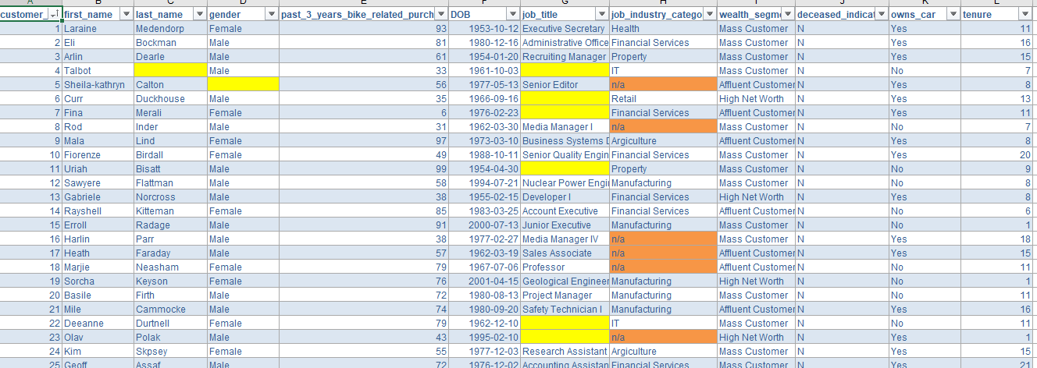
Introduction
Data Sets validation
The incorrectness of the data results in incorrect analysis(not an accurate solution)
In order to get accurate solution we the team members validate the data that was provided by you.
This will help us to understand the relations between datasets and also easy to determine customer trends and behaviour.

Slide 4
Data Exploration
EDA – Exploratory Data Analysis
1. Using gender we can predict which gender of customers are actively aspiring our service to provide security and safety instructions according to them.
2. DOB attribute can help us in prediction of age of that particular customer, which help us to suggest more service tips according to their age.
3. To get customer active address we need to relate the both tables “CustomerAddress” and “CustomerDemographic”, so that we can deliver our service to customers place which is more convenient for the customer.
4. online_order status help us to predict the actual revenue generated after paying taxes for online transactions.

Slide 5
Model Development
Prediction
1. Growth of business
2. Customer interest and opinion on our service
3. Vehicle brands we need to maintain based on customer requirement.
4. Revenue generated per year after concluding investing amount and service charges.

Slide 6
Interpretation
Business Growth Formulae
1. Average revenue by list price $1110.20 is higher than average revenue by standard cost
2. User interest on medium sized and class products compared to large and small
3. Most of users from New South Wales state.

Slide 7
Thank You

